Slide 1

AVOIDING SCAMS

Slide 2

In India, online scams are becoming increasingly common. Scammers use various techniques to trick people into providing personal information or transferring money.

Slide 3

PHISHING AND IMPERSONATION SCAMS
Scammers often send fake emails or SMS claiming to be from legitimate entities, such as banks, e-commerce websites, or government agencies like UIDAI (Aadhaar) or Income Tax Department.
These scams may ask you to click on links that take you to fraudulent websites or to provide personal details like your Aadhaar, PAN, or bank account numbers.

Slide 4

HOW TO AVOID?
Always verify emails or messages by directly contacting the official organization.
Never share personal details via email or messages, especially if you did not initiate the contact.

Slide 5

FAKE JOB AND LOAN SCAM
Fraudsters often advertise fake job opportunities, asking for an advance fee or personal information.
Similarly, there are scams offering personal loans at "low interest rates" that require an upfront payment.

Slide 6


HOW TO AVOID?
Be skeptical of job offers or loan advertisements that ask for an upfront fee.
Always check the legitimacy of job opportunities by researching the company’s official website or job boards like Naukri.com or LinkedIn.

Slide 7

ONLINE SHOPPING SCAMS
Fake websites or fraudulent e-commerce platforms may offer discounted products or services. Once you make a payment, the product is either never delivered or is counterfeit.

Slide 8


HOW TO AVOID?
Stick to well-known online shopping platforms like Amazon, Flipkart, or Myntra.
If the deal seems too good to be true, it probably is. Always check reviews and ratings of sellers before making a purchase.

Slide 9

LOTTERY OR PRIZE SCAMS
Scammers inform you via email or message that you have won a lottery or prize, but you need to pay a fee to claim it.

Slide 10

HOW TO AVOID IT?
Real lottery winners don’t have to pay fees upfront to claim their winnings.
If you receive a message claiming you've won a prize, ignore it and report it as spam.

Slide 11
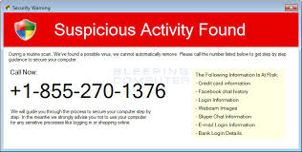
TECH SUPPORT SCAMS
In these scams, fraudsters pose as tech support agents from companies like Microsoft or Apple, claiming there’s a virus on your device and that you need to pay for repairs.

Slide 12

HOW TO AVOID?
Legitimate companies will never contact you unsolicited. Hang up immediately if you receive such a call.
Always reach out to customer support through the official website for tech issues.

Slide 13

FAKE INVESTMENT SCAMS
Investment scams, including fake cryptocurrency schemes and Ponzi schemes, have become increasingly popular in India.

Slide 14

HOW TO AVOID?
Be cautious of unsolicited investment opportunities promising high returns. Always research investments thoroughly before committing any money.

Slide 15
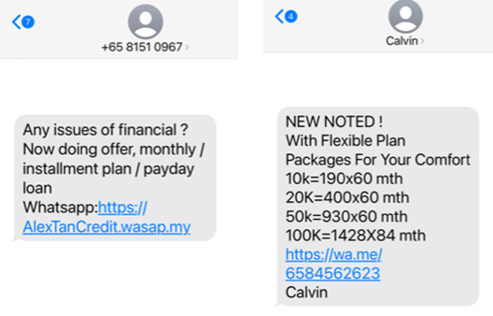
FINANCIAL REQUEST SCAM
Scammers impersonate friends, relatives, or colleagues in distress and ask for money or financial assistance through online communication platforms like WhatsApp.

Slide 16

HOW TO AVOID?
If you receive an urgent request for money, confirm the situation through a different communication channel (e.g., phone call or video call) before taking any action.

